Slide 1

TREASURER WORKSHOP
Department of florida vfw auxiliary
Notes:
WELCOME TO THE TREASURER WORKSHOP

Slide 2
TOPICS COVERED
ROLE OF A TREASURER
DIRECT DEPOSITS FROM NATIONAL
MALTA
AUXILIARY – ‘MAKE A GIFT’
IRS
RETENTION OF RECORDS
FORMS
PRESIDENT AND TREASURER BONDS
TREASURER’S REPORT
Notes:
TOPICS WE WILL COVER TODAY ARE…..

Slide 3
ROLE OF A TREASURER
Sec. 813 ‐Treasurer, Duties of (All Levels)
Duties of the Treasurer are most efficiently conducted through electronic means. Basic computer knowledge is helpful.
The Treasurer is responsible for keeping National Headquarters up to date with bank information, i.e., account number and/or routing number.
The Treasurer shall write and sign checks as voted on.
The Treasurer shall be the Treasurer of all Auxiliary committees handling funds.
All funds should be turned over to the Auxiliary Treasurer immediately. When receipts are not immediately given (50/50 drawings), it’s recommended that the person collecting the cash and at least two others assist in counting cash and write receipt
Notes:
What is the Role of an Auxiliary or District Treasurer?
Sec. 813A—Auxiliary Treasurer (District Treasure Sec 813B)
The Auxiliary Treasurer shall hold all funds and securities belonging to the Auxiliary in a FDIC or equivalent Banking Institution in the name of the Auxiliary. The most efficient means in maintaining auxiliary funds and records is through electronic means, e.g., Microsoft Excel Spreadsheets. This requires basic computer knowledge…
The Treasurer is responsible for keeping National Headquarters up to date with bank information, ie account and routing numbers. This can be handled efficiently through MALTA.
The Treasurer will write and sign checks for approved expenses
The Treasurer shall be the Treasurer or all Auxiliary committees handling funds, e.g. Raffles, Dinners, etc. All funds should be turned over to the Treasurer immediately following the fundraiser.

Slide 4
ROLE OF A TREASURER
(Continued)
All funds shall be accounted for by the Treasurer in the Auxiliary books.
  Which shall consist of a ledger, cash book, or a computerized system; and
  Printed and secured in a permanent record book So long as the records contain the same data as required formats prescribed by National Headquarters.
The Treasurer shall collect and process dues in accordance with the procedures established by the National Treasurer.
The Auxiliary Treasurer shall send the names and fees, if applicable, of the Delegates and Alternates to the Department Treasurer prior to the Department Convention.
Notes:
All money collected for the auxiliary shall be accounted for by the Treasurer and recorded in the Treasurer ledger (excel spreadsheet, cash record book). A printed copy of the Monthly Treasurers report shall be secured in a permanent Treasurers record book and Secretary minutes
The Auxiliary Treasurer shall collect and process all membership dues
The Auxiliary Treasurer shall send the names and appropriate fees of elected Delegates/Alternates for Department to the Department Treasurer prior to the Department Convention. (The District Delgates/Alternates names shall be sent to the District Secretary prior to the District Convention and the National Delegates/Alternates shall be entered into MALTA by the Secretary. There are no fees for District and National Delegates).

Slide 5

Direct Deposits
All funds to related organizations will be sent only via Electronic Funds Transfer (EFT) (aka ACH / Direct Deposit) from National Headquarters
You will be notified via e‐mail that a deposit has been made into your bank account
National is NOT going to take funds out of your account without your knowledge
You may find the form ACH Authorization Form on the VFW Auxiliary website behind login
Must submit new form if changing banks, accounts, or bank information changes (i.e. bank changes names) or enter new information in MALTA
Notes:
Direct Deposits from National Headquarters.
All funds received from National Headquarters (i.e., Membership annual pro-rata amounts) will be sent to the auxiliary via Electronic Funds Tranfser (EFT) aka ACH/Direct Deposit). This is why it is important for the Treasurer to update MALTA immediately of any changes to the bank account or routing numbers.
The Treasurer and President will receive an email from National notifying them of the deposit. National will not take any funds out of the auxiliary bank account without notifying the Treasurer and President . This is why email address must be accurate on MALTA, especially for the President, Treasurer and Secretary.

Slide 6

MALTA
MEMBERSHIP AUXILIARY LEADERSHIP TECHNOLOGY ACCESS
Input Auxiliary’s bank information
Edit annual dues amount
See detail of deposits by National
See detail of withdrawals by National
Update members information such as name or address
Process membership dues for continuous annual members
Process membership dues to convert members to life
Order membership cards
Process event registrations for National events
Run various reports
Notes:
This will take you to the multiple functions and reports needed to fullfill actions required by National through MALTA (Membership Auxiliary Leadership Technology Access)

Slide 7
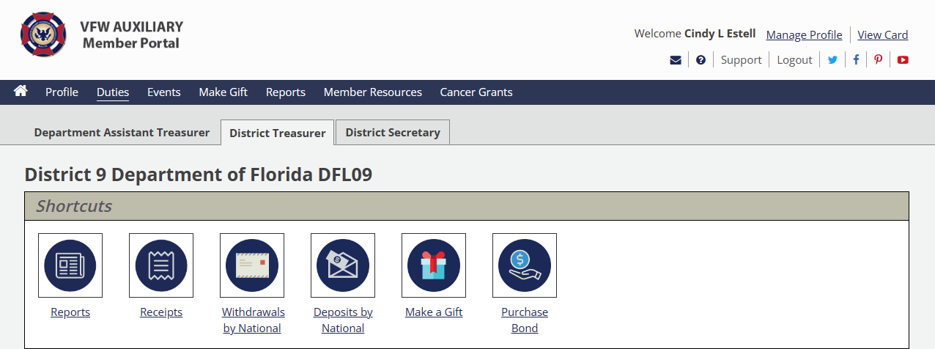
VFW Auxiliary
TREASURER DUTIES
AUXILIARY TREASURER
AUXILIARY 1234 DEPARTMENT OF FLORIDA

Slide 8
VFW Auxiliary
PRESIDENT & TREASURER BOND
AUXILIARY 1234 DEPARTMENT OF FLORIDA

Slide 9
PRESIDENT & TREASURER BOND
Section 814 of National Bylaws:
The bond must be in a sum at least double the amount of funds and value of property for which the President & Treasurer may be accountable
The amount of the bond shall be approved by the body and the bond premium shall be paid from their funds
The office of President shall hold the original bond of both offices
Any Auxiliary failing to have the office of President & Treasurer bonded shall be deprived of auxiliary representation on all levels
After the installation report is input, a bond may be purchased by the Treasurer on 7/1
If an installation report is never input, a bond cannot be purchased by the auxiliary officers
Notes:
The Bond must be in a sum at least double the amount of funds and value of property for which the Treasurer and President may be accountable for
The amount of the bond shall be approved by the membership and paid from the auxiliary funds via MALTA

Slide 10
PRESIDENT & TREASURER BOND
                (continued)
The bond runs from September 1 through August 31 each year, and the premium is due in advance prior to September 1st
Upon receipt of payment, a bond certificate will be available to the officers of the Auxiliary once the pending clearance time frame as passed
The President shall retain the Bond
The bond bonds the “offices” of the President & Treasurer. It does not bond the “individuals” holding the offices
If there is a change of President or Treasurer during the term of the bond, the new President or Treasurer is bonded without further action

Slide 11
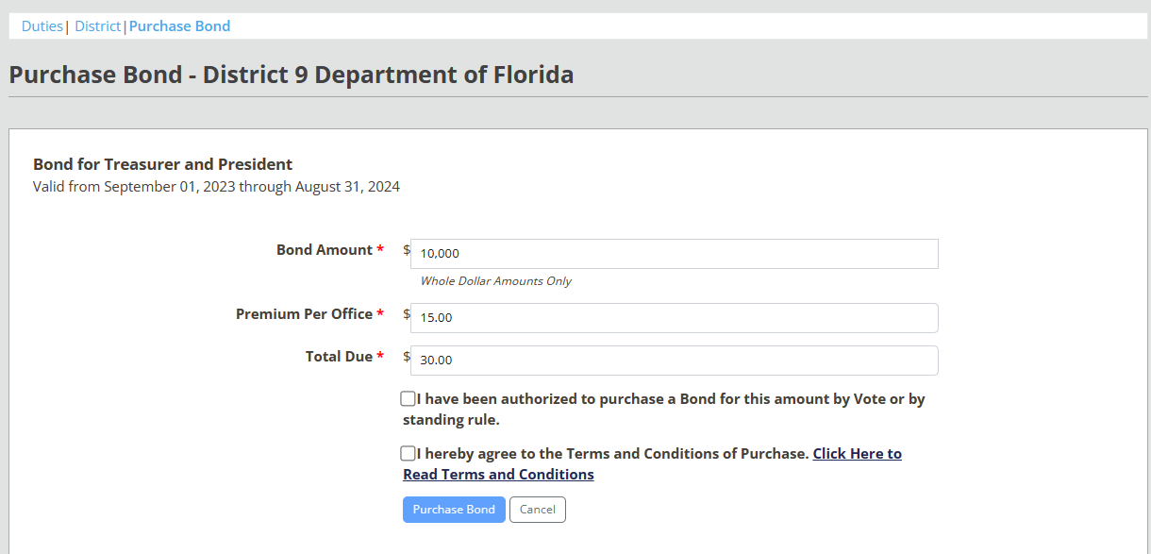
VFW Auxiliary
PRESIDENT & TREASURER BONDS
Auxiliary 1234 Department of Florida

Slide 12
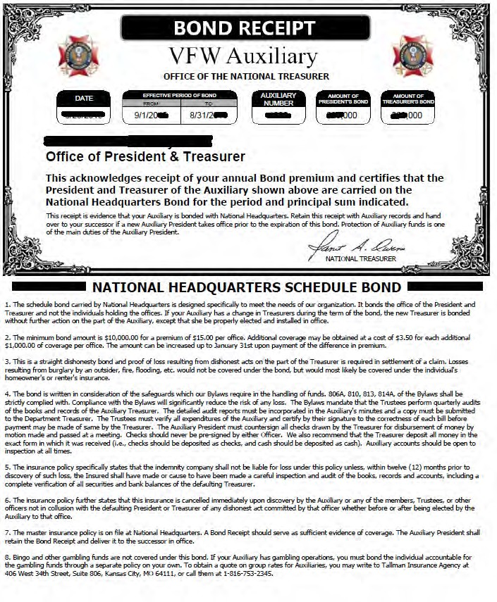

Slide 13
VFW Auxiliary
TREASURER DUTIES – MAKE A GIFT
AUXILIARY TREASURER
AUXILIARY 1234 DEPARTMENT OF FLORIDA

Slide 14
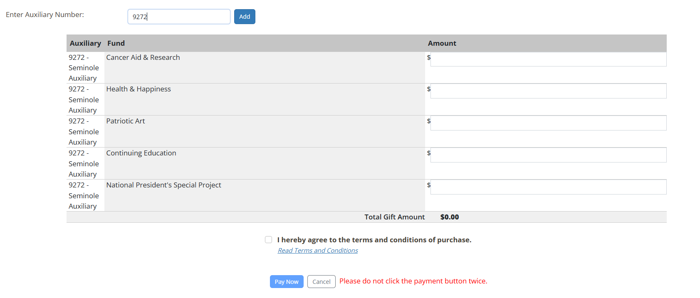
VFW Auxiliary
TREASURER DUTIES – MAKE A GIFT

Slide 15
NEW AUXILIARY TREASURER (Notifying the IRS)
Need to notify IRS of change in responsible party
File form 8822‐B with the IRS within 60 days of election
Ensures IRS correspondence goes to the new Treasurer
Form can be found on‐line at www.irs.gov
Notes:
How many new Treasurers are here today?
If you are a new Treasurer you must complete the IRS form 8822-B and send it to IRS immediately.
The form can be found on-line at www.irs.gov or on the Department website at www.vfwauxfl.org under the Resources/Treasurer and/or President and Secretary links

Slide 16
TAX DEDUCTIONS FOR CONTRIBUTIONS MADE TO AN AUXILIARY
501 (c)19 organizations
Internal Revenue Manual, Part 7, Chapter 25, Section 19 of IRS Rulings and Agreements:
Internal Revenue Code 170(c)3 provides income tax deduction for contributions to a post of “War Veterans” if at least 90% of members are war veterans
The majority of members to the VFW Auxiliary are NOT War Veterans

Slide 17
990‐N e-Postcard
Due within 4 ½ months after the end of the organization’s fiscal year
Section 920 of Bylaws the fiscal year end is June 30th
990‐N e-Postcard is due by November 15th each year
Information needed to complete the 990‐N e-Postcard:
Your organization's employer identification number (EIN)
Your organization's legal name
Any other names your organization uses to do business (DBA name)
Able to answer the following questions:
  Are the gross receipts normally $50,000 or less?
  The organization's mailing address, city, state and zip code
  The organization's website address (if it has one)
  The name and address of one of your organization’s principal officer
  990‐N e-Postcard user guide
  at www.Irs.Gov/pub/irs‐pdf/p5248.Pdf
Notes:
990N e-Postcard are due by November 15th each year

Slide 18

AUXILIARY TREASURER’S REPORT
At each Auxiliary meeting, the Treasurer shall make a report following the reading of the minutes
The Auxiliary Treasurer’s Report shall contain:
Balance on hand as of the last report (Beginning Balance)
Amount of funds received from all sources since the last report
Amount expended since last report
Balance on hand (Ending Balance)
The report must show all receipts and disbursements in detail, including the name of the person or organization to whom the check is issued and stating for what purpose

Slide 19
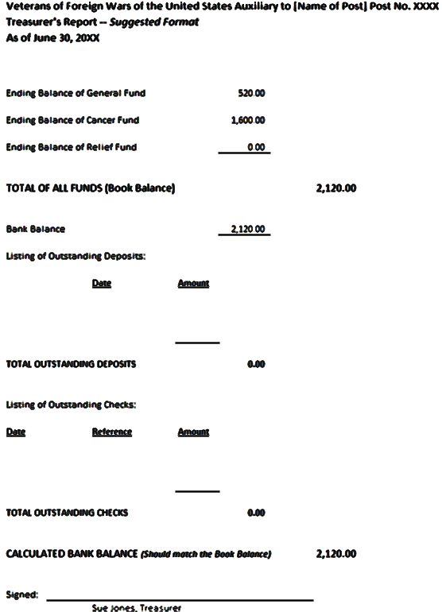
AUXILIARY TREASURER’S REPORT
Meeting to Meeting Activity

Slide 20

AUXILIARY
TREASURER’S REPORT
A copy of the Treasurer’s Report goes to the Secretary to be included in the minutes
As per the Auxiliary Order of Business, after the Treasurer’s report it is customary for the Presentation of Bills to be approved to be paid

Slide 21

RETENTION OF AUXILIARY RECORDS
Most accounting records = 6 years
Accounts Receivables
Accounts Payables
Canceled Checks
Bank Statements
Great resource
Booklet of Instructions in Bylaws (yellow pages)
Paper vs. electronic file keeping
Notes:
Retention of Auxiliary Records is located in the Booklet of Instructions section of the National Bylaws

Slide 22
IMPORTANT FORMS
MEMBERSHIP SUMMARY FORM
2025-2026 CONTRIBUTION FORM
MEMBER CHANGE/UPDATE FORM
MEMBERSHIP APPLICATION

Slide 23
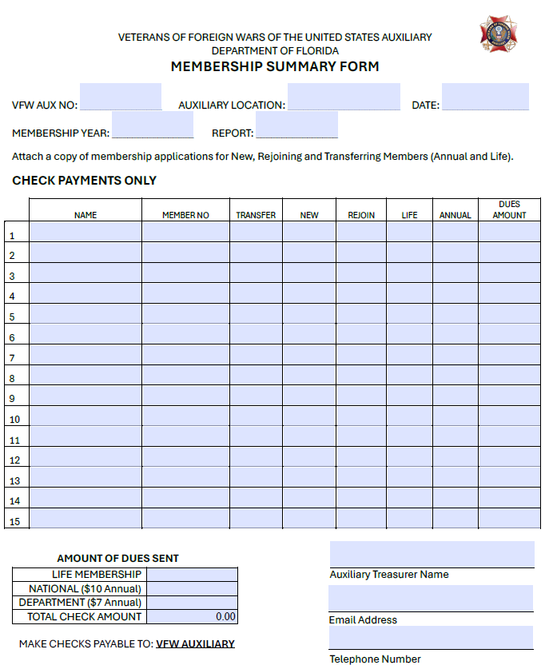
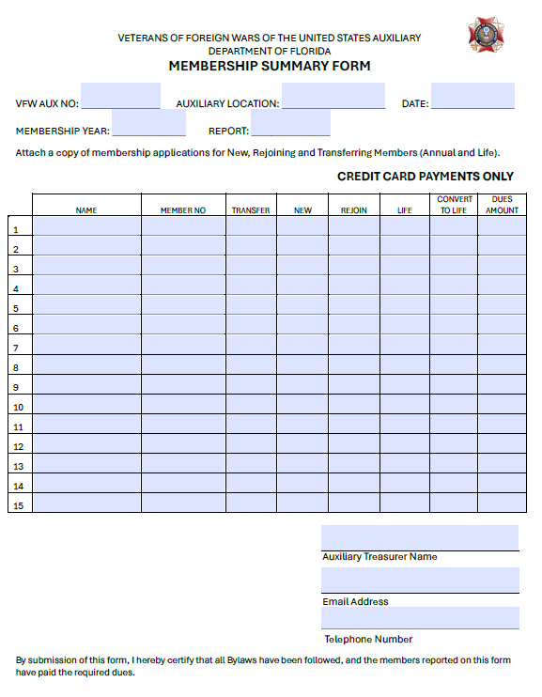
MEMBERSHIP SUMMARY FORMS

Slide 24
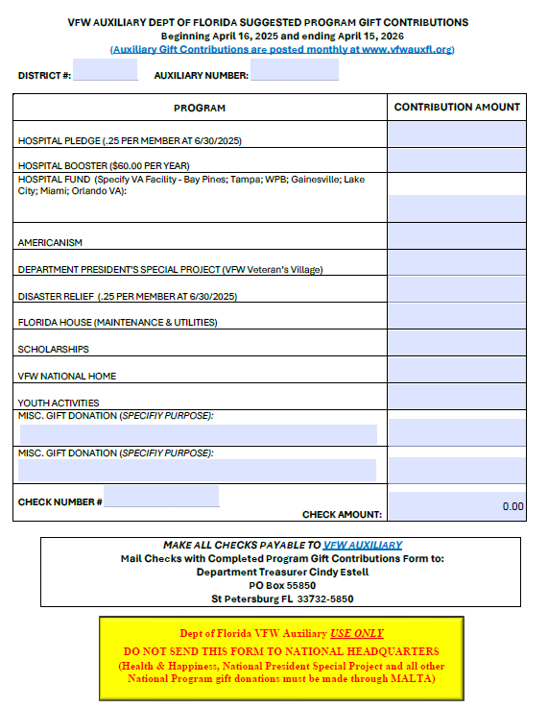
2025-2026 CONTRIBUTION FORM

Slide 25
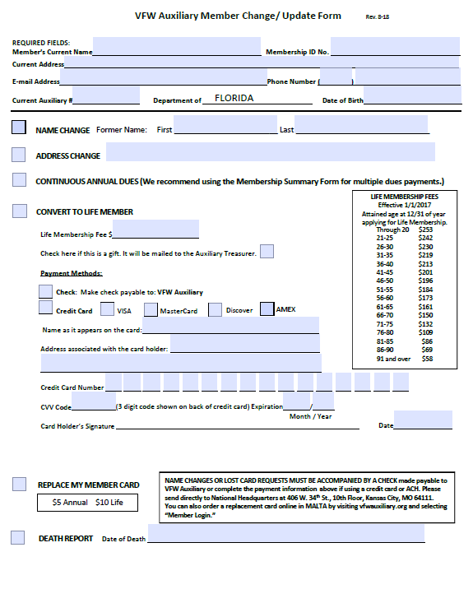
MEMBER CHANGE/UPDATE FORM
Used for Convert to Life Member –Cash Payments can be processed on MALTA by Auxiliary Treasurer under Duties
Used for Convert to Life Member Credit Card Payments sent to Department Treasurer to process

Slide 26
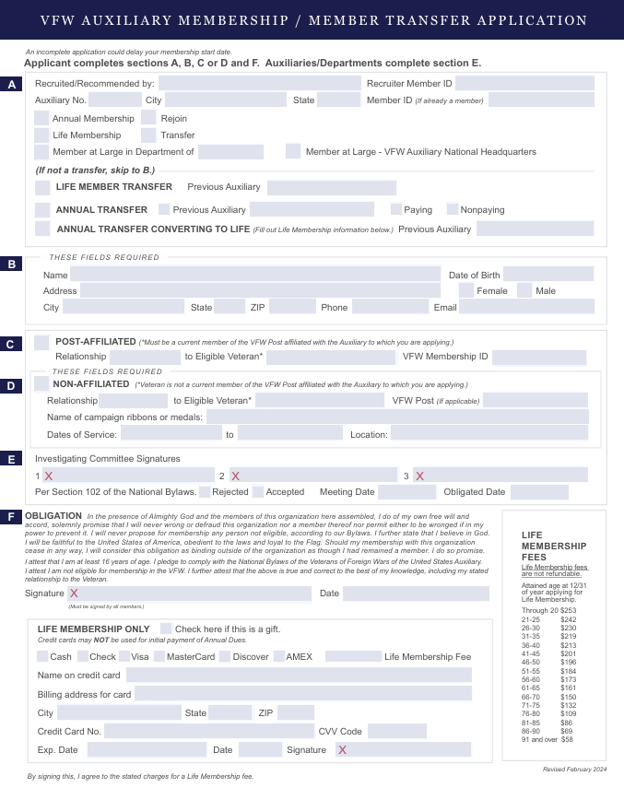
MEMBERSHIP APPLICATION

Slide 27

ANNUAL MEMBERSHIP CARDS
Annual membership cards will be sent directly to the member approximately two weeks after the payment has been processed in MALTA.
Temporary membership cards can be accessed in MALTA while waiting for membership card to arrive.

Slide 28

LIFE MEMBERSHIP CARDS
Card issued free of charge when life membership is purchased.
    If not received in 2 months by member – notify HQ. If 4 months elapses, must pay $10 for new card
    New life card issued free if transferring Auxiliaries
      No card will automatically be issued for transfer to at large or transfer back to an Auxiliary where previously a member
    $10 fee for replacement for:
    Name change
    Damaged / Lost / Stolen

Slide 29

BUILDING BRIDGES
FOR OUR VETERANS
Questions?

